Slide 1
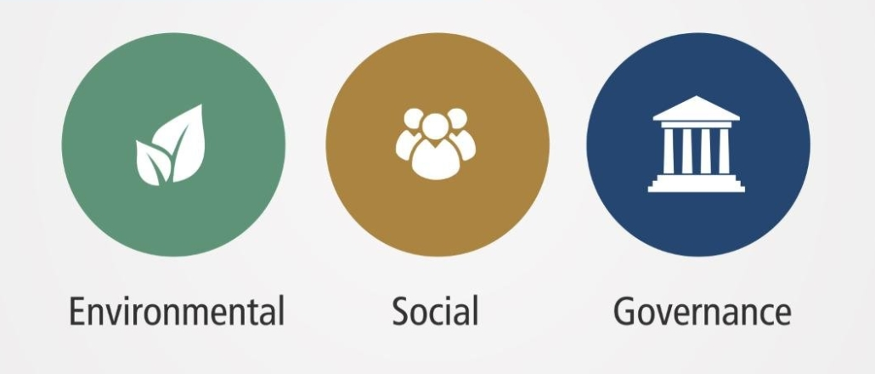
Event driven responsible investment
Pierre Quemard – 7th April 2021

Slide 2


Environmental and Social crisis
Pandemic accelerated adoption
Social injustice
New investors with government incentives
Corona Crisis Accelerated ESG investment - source
Notes:
Since the rise of the pandemic, clear problematic of social injustice and environmental issue are facing the surface. Investors are way more regarding on the impact of their investement and not only focus on ROI In the same time a lot of new investors are flooding the market, think about the Gamestop event.

Slide 3
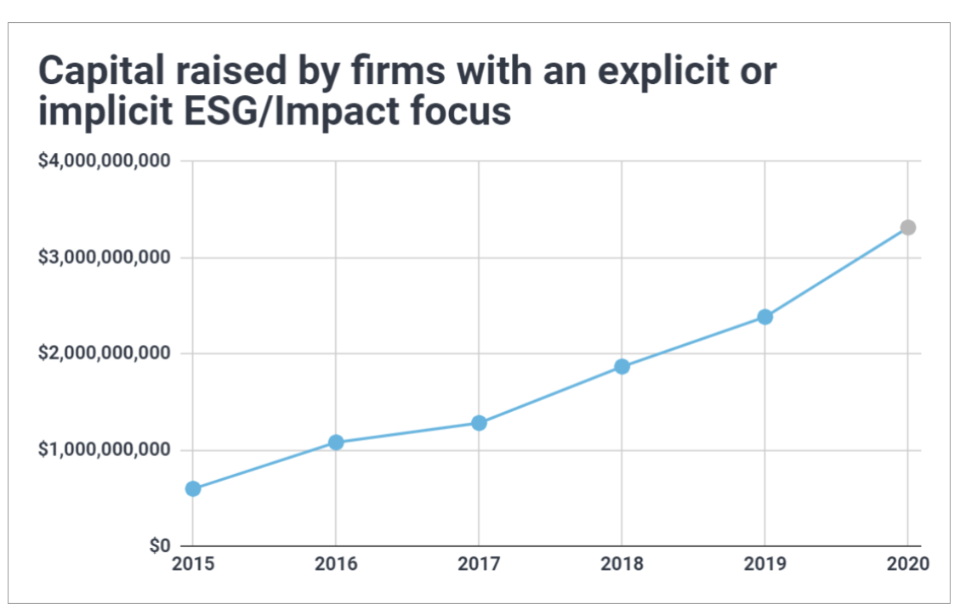
The rise of ESG
ESG outperform S&P 500 - source
Public Benefit as a viable Growth – Morgan Stanley
Source
$45.6 billion was invested in ESG investment funds in the first quarter of this year – Morning Star

Slide 4
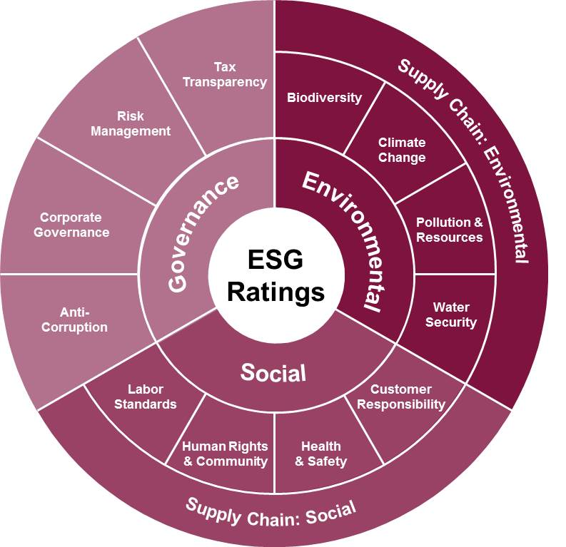
The visibility challenge
Investors demand visibility
Data is unreliable
Too many sources
Many messaging technologies
ESG Rating sources are hard to monitor – MSCI

Slide 5
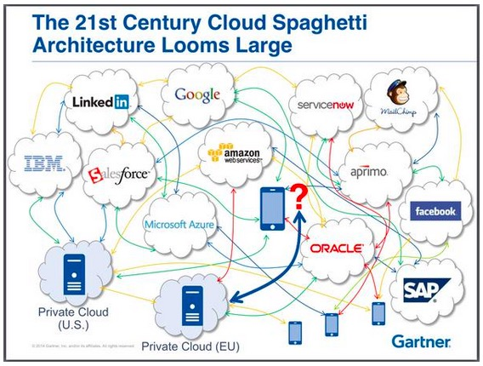
One queue to rule them all
Notes:
Multiple data sources from different clouds
Different tech stack Kafka AMQ Spring
Unreliable topic subscription
Complex app creation

Slide 6



ESG Dashboard demo scenario
Solace Mesh Event
Local publisher of rating and sentiment MQTT Local instance of Solace
Cloud instance of Solace on AWS
Dashboard connected to Solace Cloud using SMF

Slide 7
Going beyond
Aggregate multiple sources
Auto-generate AsyncAPI
Protocol agnostic
Control client Access with ACL profiles

Slide 8
Any questions ?

